Slide 1
REMEDY RELATIONSHIP OF SILICEA PRESENTED BY: DR. SONNY MON .R ASSITANT PROFESSOR , DEPT OF ORGANON OF MEDICINE.

Slide 2
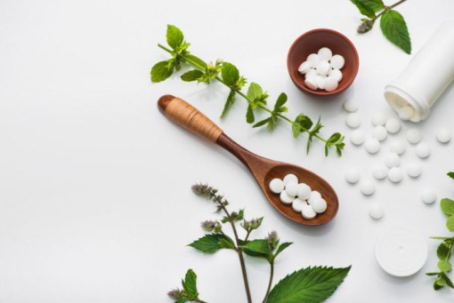
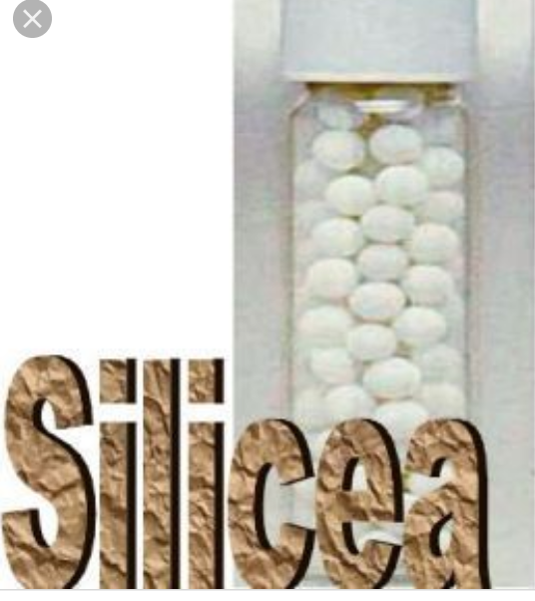
REMEDY
RELATIONSHIP OF

Slide 3
REMEDY RELATIONSHIP
Relationship” indicates: The way in which two or more things are connected, or the state of being connected. Remedy indicates: a medicine or Treatment for a disease or injury. Thus it is a connection or relation between two or more medicine. Dr.Boenninghausen is considered to be a pioneer of this concept.

Slide 4
REMEDY RELATIONSHIP OF SILICEA
COMPLEMENTARY:
Complementary remedies those that have certain characteristics in common, certain similarities, yet they probe deeper into the constitutional state than the first remedy given, which may have been more superficial in nature, more acute in its indications.
These are the remedies which complete the action of the first prescription (the similimum).

Slide 5
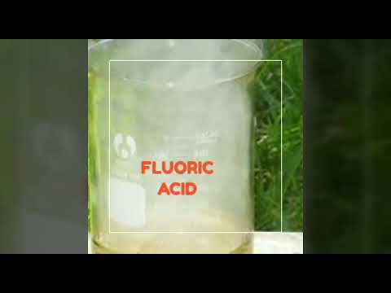
THUJA
PULSATILLA
SILICEA
SANICULA
AQUA
FLURIC ACID

Slide 6
ANTIDOTE:
An antidote is a substance which can counteract a form of poisoning.
In Homoeopathic system ,appearance of new symptoms after first prescription indicates that remedy is not perfectly homoeopathic to the case , and it has to be antidoted.
If new symptoms are symptoms of the remedy –the patient is proving the prescribed remedy.
If the new symptoms are not the symptoms of the prescribed remedy –that is mistake in selection of the first prescription .Thus antidote should be given.

Slide 7
SILICEA ANTIDOTES
MERC
COR
SULPH
CAMPH
SILICEA IS
ANTIDOTED
BY
FL. ACID
HEPAR

Slide 8
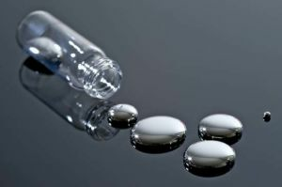
INIMICAL (INCOMPATIBLE):
These are the remedies which don’t follow eachother well...
MERCURIOUS
SILICEA

Slide 9
SILICEA :
FOLLOWS WELL : BELL.,BRY., CALC., CALC.P., CIN., GRAPH., HEP.,IGN.,NIT.AC., PHOS.
FOLLOWED WELL BY:
HEP., FL.AC.,LACH.,LYC.,SEP
“SILICEA “is the Chronic of PULSATILLA

